Slide 1

DESIGN THINKING GUIDE - FOR COACHES
PROPOSED PROCESS
CREATIVITY CAMP
Mini Entreprises 2021-2022

Slide 2
i1. INTRODUCTION
Contexte JEL
Mini-Entreprise (explanation & goals)
Goals of today:
Learn the Design Thinking process
Search for business idea or the problem that will be solved

Slide 3
i2. DESIGN THINKING
Introduction
What is Thinking?
What is Design?
What is Design Thinking? (various explanations)
What is it for?

Slide 4
i3. MORE THAN JUST A PROCESS
Multidisciplinary
Workspace
Process

Slide 5
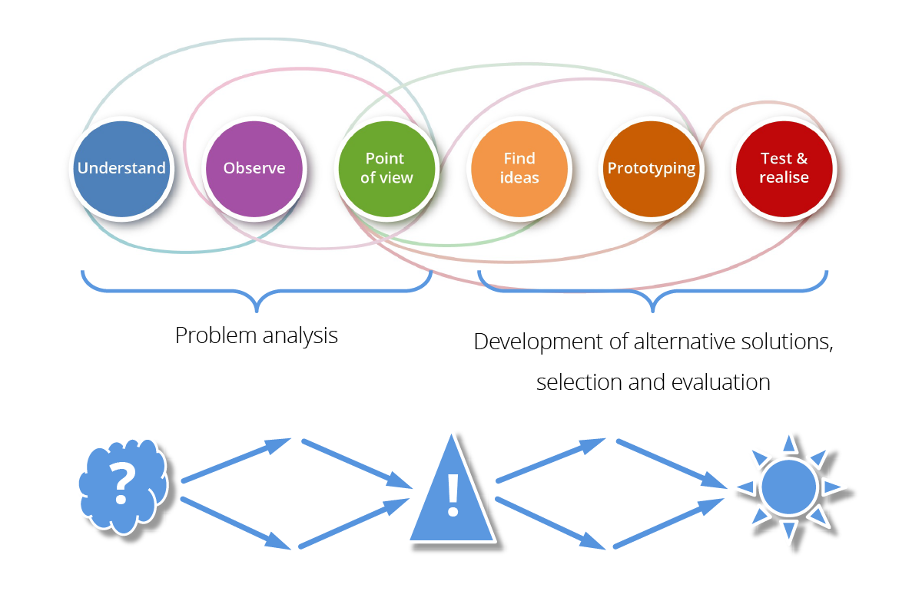
i4. THE DT PROCESS
- The 6 phases – Feedback and loops
- Group the phases in “Problem deﬁnition“ and “Problem solving“

Slide 6
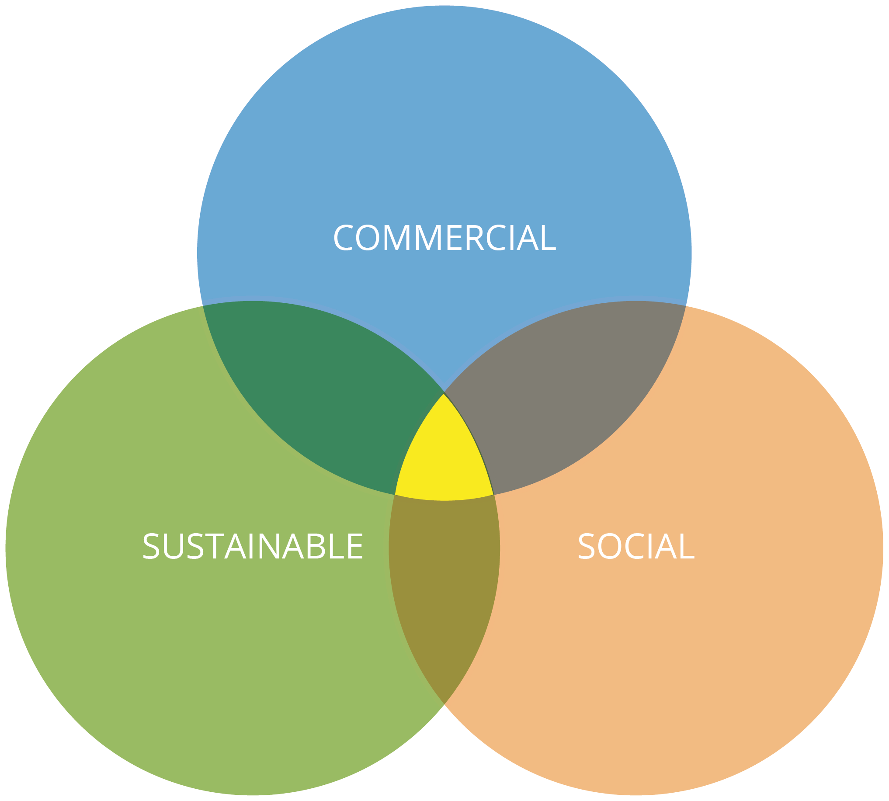


i5. TOPICS AND FRAMEWORK

Slide 7
1. GROUPS COMPOSITION
≈20 minutes
„Creative Team Model“
by competences and/or interests
if possible, avoid “friends groups”
Write it down on your badge!

Slide 8
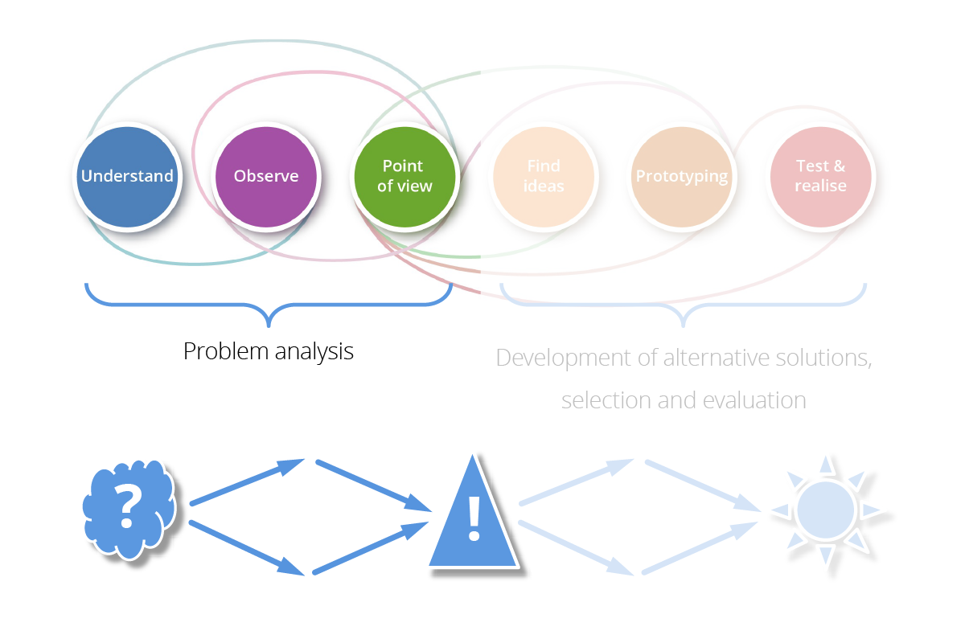
2. WORKSHOP PART I
≈120 minutes
- Looking for the “problem”
- Detect the “problem”
- Define the “Problem”
Q: Does the definition address the real problem?

Slide 9
3. WORKSHOP PART I
≈120 minutes
FORMAT
Split „Problem analysis“ in 2 small phases:
1. Develop many ideas of problems
2. Discuss and select the best

Slide 10
TIPS
4. WORKSHOP PART I
  Process:
  5 min. working alone (no talking) on post-ist;
  ≈20 min. presenting indivual results and discussing in the group;
  Presenting in front of the class with Q&A
  Mission (Preparation for next time): Ask your family, friends and others if they agree with the definition of the problem.
Perhaps it would be a good idea to do this phase in 2 parts. It will give them more time to research, think and discuss.
Put on the group tables: Handouts of the DT process and tools (from the presentation) you want to share

Slide 11
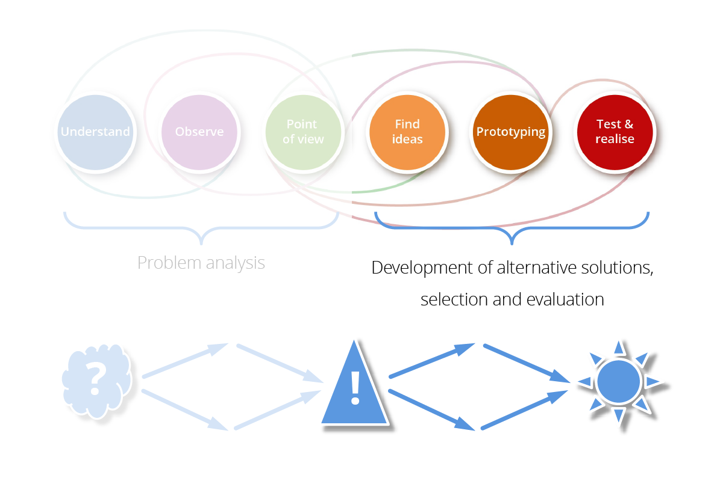
5. WORKSHOP PART II
≈120 minutes
FORMAT
Split „Development of...“ in 2 smaller phases:
1. Develop many ideas of solutions (go wild, defer judgement...)
2. Present, discuss and select the best

Slide 12
TIPS
6. WORKSHOP PART II
Process:
  5 min. working alone (no talking) on post-ist;
  ≈20 min. presenting indivual results and discussing in the group;
  ≈10 min. „Stealing from the others“ phase;
  Present the best solution(s) in front of the class with Q&A
If possible, do this in one session
In case it is difficult to select the best solution:
  Try to combine the ideas
  Decide on the next meeting of the group (allow time for reflection)
How could the idea(s) be prototyped and feedback gathered?
As soon as possible (Is the idea viable? – Let them present what they want to do. )
Put on the group tables: Handouts of the DT process and tools (from the presentation) you want to share

Slide 13
TIPS
AT THE START OF A MEETING
What happened since the last meeting?
Content
Collaboration
Happiness

Slide 14
TIPS
AT THE END OF A MEETING
What are the next steps?
Action plan is defined
Everybody has a responsibility
Planning is adapted
Is everyone satisfied with what has been discussed?
Set next meeting

Slide 15


Jan Glas
jan@yellowball.lu

